Slide 1
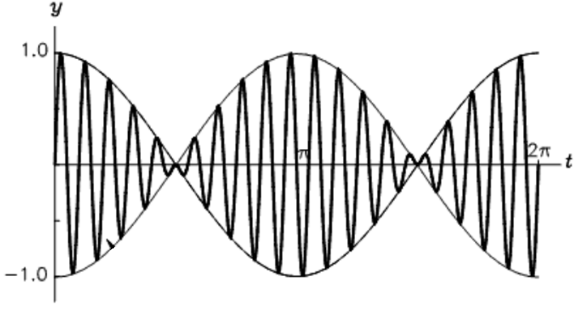
Lecture 21: Countercyclical policy
Outline
Cycles: the self-correcting mechanism
Closing the gap
Fiscal policy
Required Reading
Mishkin Ch 12: selections

Slide 2
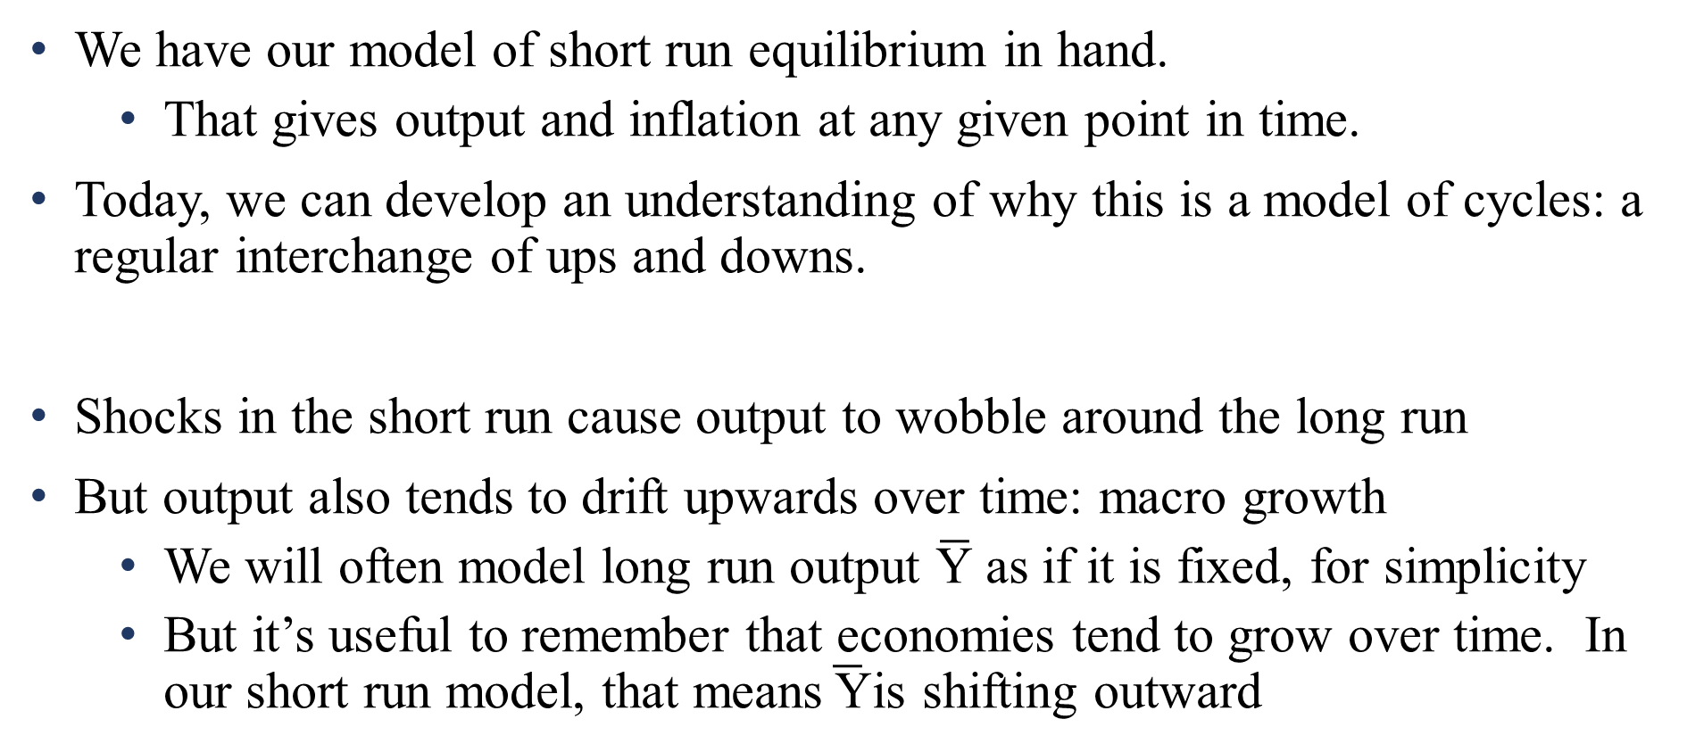
Cycles: the self-correcting mechanism
We have our model of short run equilibrium in hand.
That gives output and inflation at any given point in time.
Today, we can develop an understanding of why this is a model of cycles: a regular interchange of ups and downs.
Shocks in the short run cause output to wobble around the long run
But output also tends to drift upwards over time: macro growth
We will often model long run output $\overline{\text{Y}}$ as if it is fixed, for simplicity
But it’s useful to remember that economies tend to grow over time. In our short run model, that means$\overline{ \text{Y}}$is shifting outward

Slide 3
Cycles: the self-correcting mechanism
The long run represents an economy where all prices are flexible, and so all markets clear: full resource utilization at their natural rates.
Think back to the aggregate production function
LRAS shifters are things that change supply-side fundamentals
Resource stock: more K, L, and HC to plug into the production fc’n
Technology: use the existing stock of resources more effectively
Institutional changes: changes in “the way things are done” or “the rules of the game
E.g., adopting/abandoning markets. Erosion or improvement in the rule of law. Changes in class/racial/gender equality in market access
Notes:
Notice that LRAS shifters are about the ABILITY to take inputs and turn them into output. The SRAS shifters are about the INVENTIVES to use those inputs: profits, output prices, and resource costs.
Naturally, we talked about institutions (in relation to efficiency and total factor productivity) in the growth section. “Institutions,” in the economist’s typical usage, just means “practices” or “things that guide/dictate” practices. These sorts of changes allow an economy to use resources more (or less) efficiently. Often involve changing the underlying incentive structure of markets, and the underlying legal structure of government. (China in the 1970s is a good example, as we saw at the beginning of our growth lectures). Can also include social norms, religiosity, morality, etc. Just as in the Solow Growth model – institutions are a growth-shifter!

Slide 4
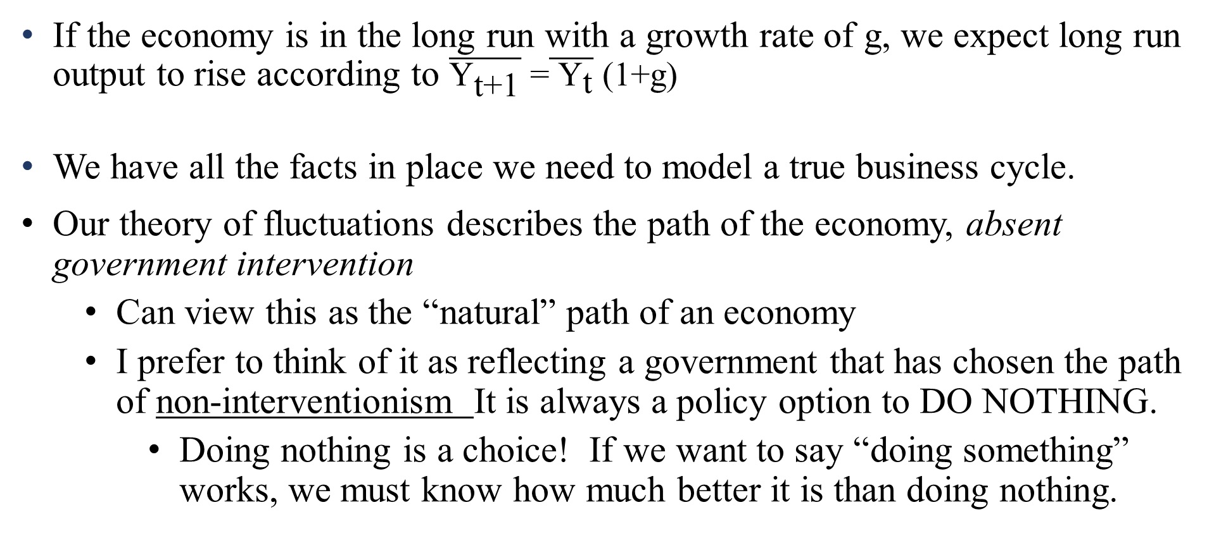
Cycles: the self-correcting mechanism
If the economy is in the long run with a growth rate of g, we expect long run output to rise according to $\overline{{\text{Y}}_{\text{t}\text{+1}}}\text{ =}\overline{{ \text{Y}}_{\text{t}}} \text{(1+}\text{g}\text{)}$
We have all the facts in place we need to model a true business cycle.
Our theory of fluctuations describes the path of the economy, absent government intervention
Can view this as the “natural” path of an economy
I prefer to think of it as reflecting a government that has chosen the path of non-interventionism It is always a policy option to DO NOTHING.
Doing nothing is a choice! If we want to say “doing something” works, we must know how much better it is than doing nothing.
Notes:
This is a basic principle of policy evaluation. To know the effect of some action, we must also know what WOULD have happened in the counterfactual. In any given situation, we either do something or we do nothing. But we definitely do one of those two things! Which means we never, for any given circumstance, see both at the same time in the same situation. The thing we didn’t do is the counterfactual: the outcome in the world that never happened.
A central reason we model is to understand: what would have happened, if we made different choices? Understanding that is central to the basic principle of the scientific method! Experiments work by creating two groups, one where we do “something” and another where we do “nothing”. It’s hard to do that when we’re talking about things like total government spending or the average income tax rate.

Slide 5

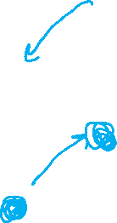
Cycles: the self-correcting mechanism
Consider an economy initially in the long run, which then experiences a positive AD shock
Output demanded is now higher than can be produced at the natural rate of unemployment
Prices are now rising faster than when wage contracts were created
π
LRAS
SRAS₁
π₂= 6%
π₁= 4%
AD₂
AD₁
$$\overline{Y}=$$
$30
$36
Y

Slide 6
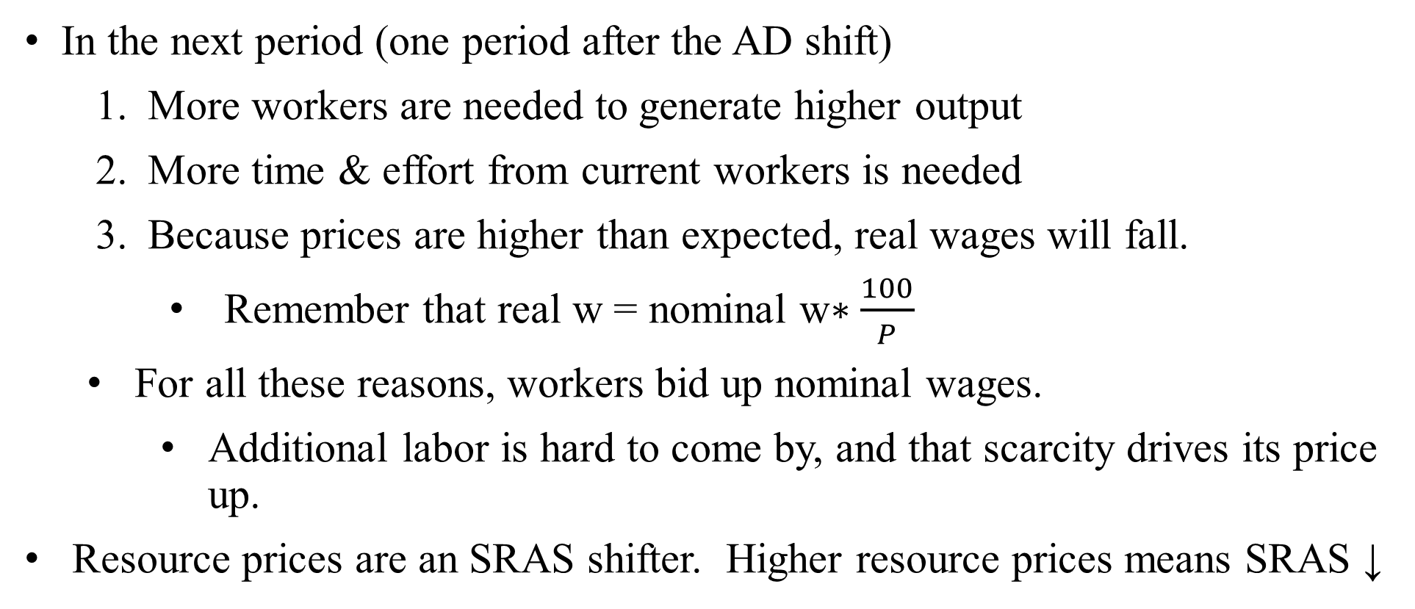
Cycles: the self-correcting mechanism
In the next period (one period after the AD shift)
More workers are needed to generate higher output
More time & effort from current workers is needed
Because prices are higher than expected, real wages will fall.
Remember that real w = nominal w$∗\frac{100}{P}$
For all these reasons, workers bid up nominal wages.
Additional labor is hard to come by, and that scarcity drives its price up.
Resource prices are an SRAS shifter. Higher resource prices means SRAS ↓

Slide 7

Cycles: the self-correcting mechanism
SRAS₃
For this shift, inflation rises even higher!
The demand for labor remains higher than “natural”
Wages will continue to rise
The process will only stop when inflation stops rising.
LR equilibrium is set by AD = LRAS
That gives the new π_{LR}
π
LRAS
SRAS₁
π_{LR}= 10%
π₃= 8%
π₂= 6%
AD₂
AD₁
$$\overline{Y}=$$
$30
$32
$36
Y

Slide 8
Cycles: the self-correcting mechanism
SRAS₄
Given the positive AD shock, SRAS will continue to shift inward until π = π_{LR}
At that point, there is no excess demand for labor
Inflation is stable and predictable; wage contracts don’t need to be re-negotiated
The economy will remain at this new equilibrium, where SR=LR (absent more shocks)
π
LRAS
SRAS₁
π_{LR}= 10%
π₁= 4%
AD₂
AD₁
$$\overline{Y}=$$
$30
Y

Slide 9
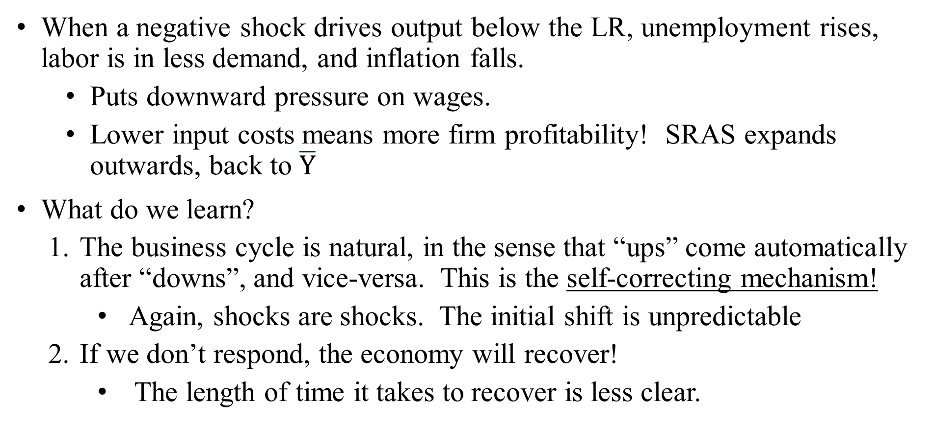
Cycles: the self-correcting mechanism
When a negative shock drives output below the LR, unemployment rises, labor is in less demand, and inflation falls.
Puts downward pressure on wages.
Lower input costs means more firm profitability! SRAS expands outwards, back to $\overline{Y}$
What do we learn?
The business cycle is natural, in the sense that “ups” come automatically after “downs”, and vice-versa. This is the self-correcting mechanism!
Again, shocks are shocks. The initial shift is unpredictable
If we don’t respond, the economy will recover!
The length of time it takes to recover is less clear.

Slide 10
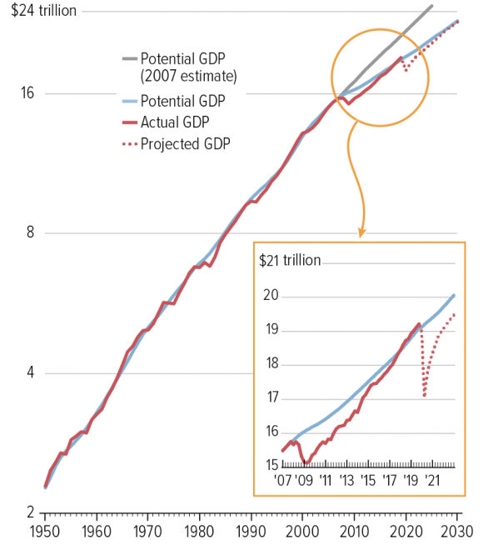
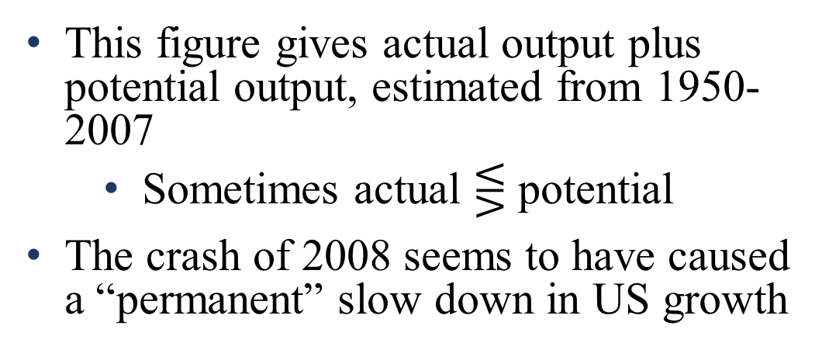
Cycles
This figure gives actual output plus potential output, estimated from 1950-2007
Sometimes actual $⋚$ potential
The crash of 2008 seems to have caused a “permanent” slow down in US growth
OG in 1981 ≈ - $600 b / $7,500 b
≈ - 8%
OG in 2009 ≈ - $1,100 b / $16,200 b
≈ - 6.8%
Estimated OG in 2020 ≈ - $2,200 b / $19,300 b
≈ - 11.4%
Notes:
Figure from https://www.cbpp.org/research/economy/chart-book-tracking-the-post-great-recession-economy
1981 OG from https://www.philadelphiafed.org/-/media/research-and-data/publications/business-review/2011/q1/brq111_output-gaps-uses-and-limitations.pdf

Slide 11
Closing the gap
The principles of countercyclical policy say that welfare is maximized when our collective income is “smoothed”:
That is, national income and output stay on a stable long run path without all the ups and downs of the business cycle
There are many ways to cause output to return to its long run level
One policy option is “do nothing”: the self correcting mechanism
The alternative is “do something”!
Given our framework, there are many “somethings” we can do
Fiscal policy
Monetary policy

Slide 12
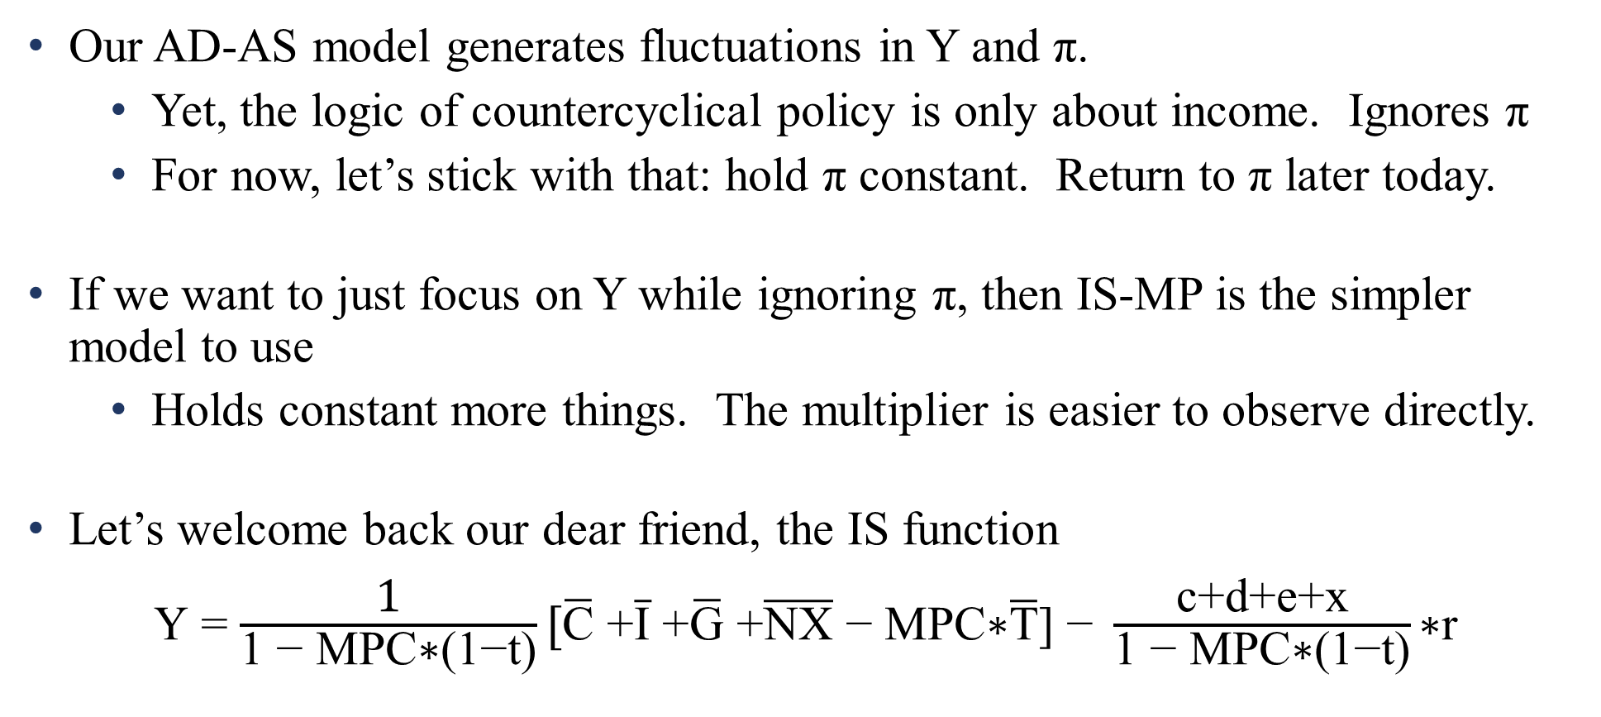
Closing the gap
Our AD-AS model generates fluctuations in Y and π.
Yet, the logic of countercyclical policy is only about income. Ignores π
For now, let’s stick with that: hold π constant. Return to π later today.
If we want to just focus on Y while ignoring π, then IS-MP is the simpler model to use
Holds constant more things. The multiplier is easier to observe directly.
Let’s welcome back our dear friend, the IS function
$\text{Y}$ = $\frac{\text{1}}{\text{1 − }\text{MPC}\text{∗(1−}\text{t}\text{)}}[\overline{\text{C}}\text{ +}\overline{\text{I}}\text{ +}\overline{\text{G}}\text{ +}\overline{\text{NX}}\text{ − }\text{MPC}\text{∗}\overline{\text{T}}\text{] − }\frac{\text{c}\text{+}\text{d}\text{+}\text{e}\text{+}\text{x}}{\text{1 − }\text{MPC}\text{∗(1−}\text{t}\text{)}}\text{∗}\text{r}$
Notes:
Suppose you’ve forgotten this is IS. How do we know this is IS?
it’s a statement of aggregate expenditure: it’s got C, I, G, and NX.
It relates output Y to the real interest rate r. There is no inflation in this equation (if it had inflation rather than r, it would be AD!)

Slide 13
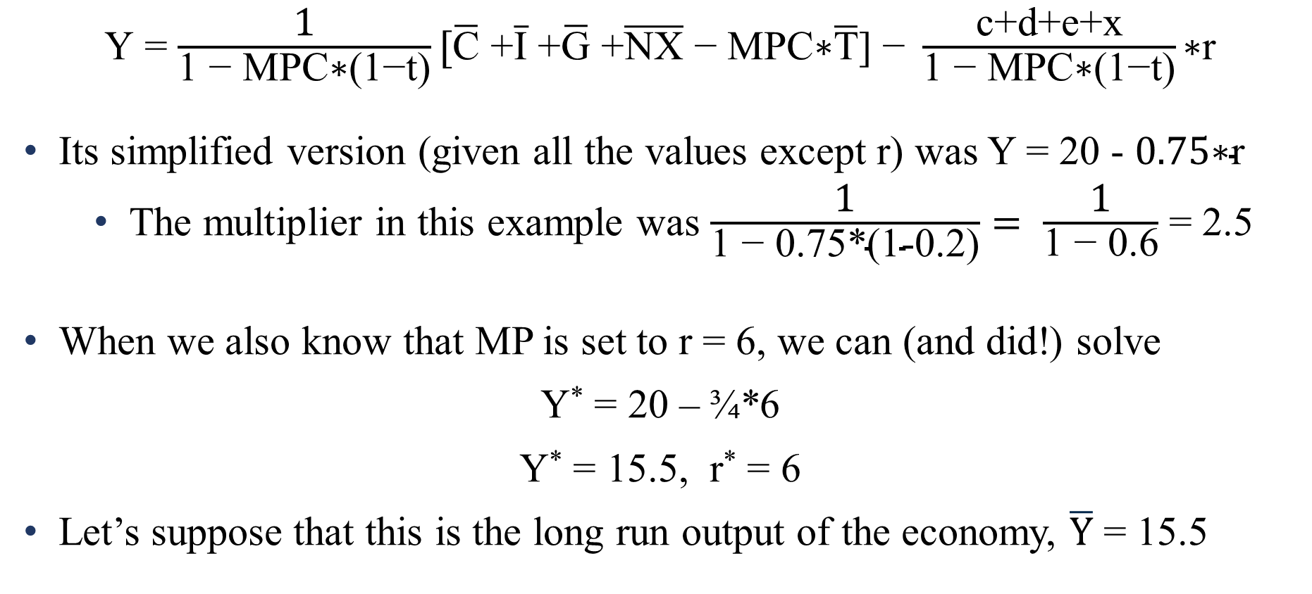
Closing the gap
$\text{Y}$ = $\frac{\text{1}}{\text{1 − }\text{MPC}\text{∗(1−}\text{t}\text{)}}[\overline{\text{C}}\text{ +}\overline{\text{I}}\text{ +}\overline{\text{G}}\text{ +}\overline{\text{NX}}\text{ − }\text{MPC}\text{∗}\overline{\text{T}}\text{] − }\frac{\text{c}\text{+}\text{d}\text{+}\text{e}\text{+}\text{x}}{\text{1 − }\text{MPC}\text{∗(1−}\text{t}\text{)}}\text{∗}\text{r}$
Its simplified version (given all the values except r) was Y = 20 - $0.75\text{∗}\text{r}$
The multiplier in this example was $\frac{\text{1}}{\text{1 − 0.}\text{75∗(1−0.2)}}= \frac{\text{1}}{\text{1 − 0.6}}$ = 2.5
When we also know that MP is set to r = 6, we can (and did!) solve
Y* = 20 – ¾*6
Y* = 15.5, r* = 6
Let’s suppose that this is the long run output of the economy, $\overline{Y}$ = 15.5
Notes:
Let me stress again, that the equation up top is ALWAYS true. It’s the general version of the equation. The version with particular numbers is just one example.
In this example, MPC = 0.75 and t = 0.2

Slide 14
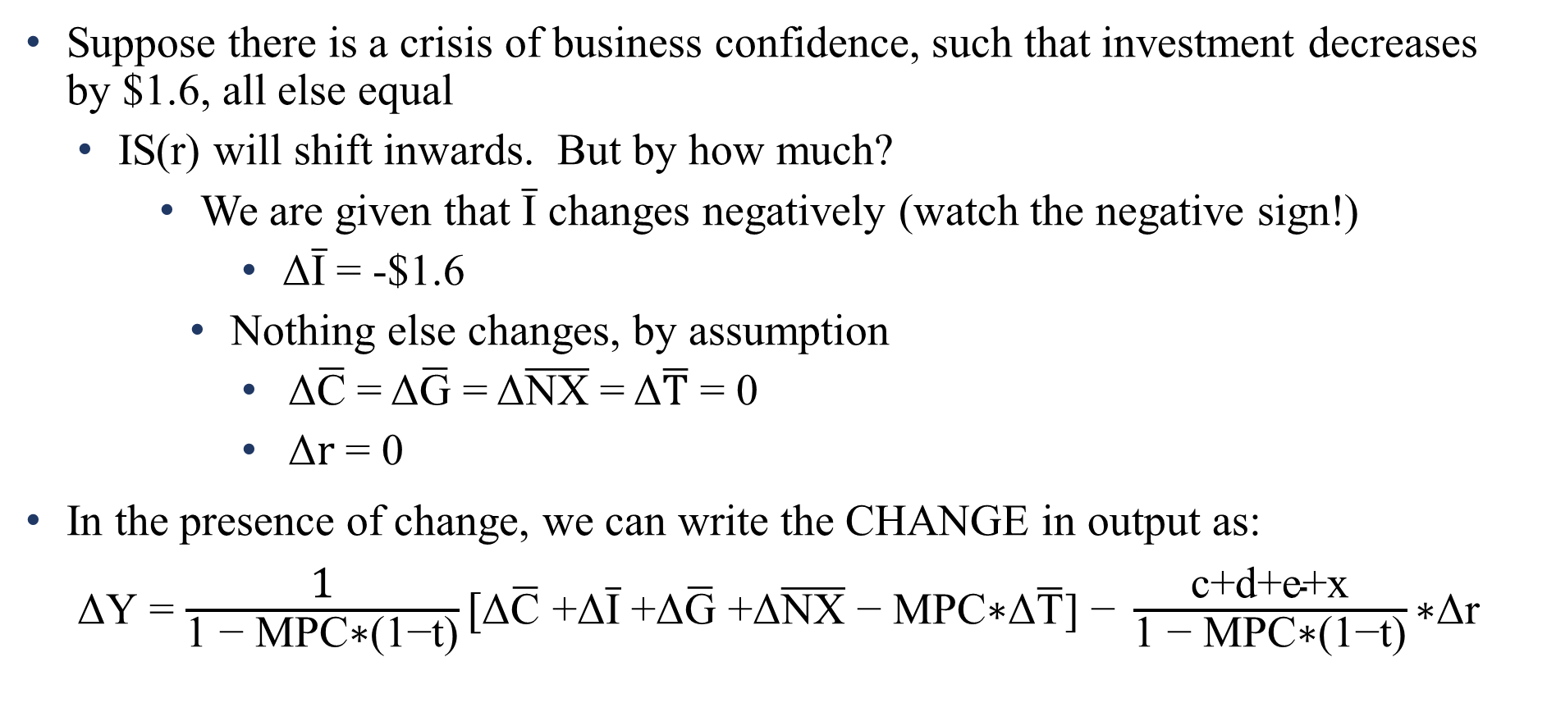
Closing the gap
Suppose there is a crisis of business confidence, such that investment decreases by $1.6, all else equal
IS(r) will shift inwards. But by how much?
We are given that $\overline{\text{I}}$ changes negatively (watch the negative sign!)
Δ$\overline{\text{I}}$ = -$1.6
Nothing else changes, by assumption
Δ$\overline{\text{C}}$ = Δ$\overline{\text{G}}$ = Δ$\overline{\text{NX}}$ = Δ$\overline{\text{T}}$ = 0
Δ$\text{r}$ = 0
In the presence of change, we can write the CHANGE in output as:
$\text{Δ}\text{Y}$ = $\frac{\text{1}}{\text{1 − }\text{MPC}\text{∗(1−}\text{t}\text{)}}[\text{Δ}\overline{\text{C}}\text{ +}\text{Δ}\overline{\text{I}}\text{ +}\text{Δ}\overline{\text{G}}\text{ +}\text{Δ}\overline{\text{NX}}\text{ − }\text{MPC}\text{∗}\text{Δ}\overline{\text{T}}\text{] − }\frac{\text{c}\text{+}\text{d}\text{+}\text{e}\text{+}\text{x}}{\text{1 − }\text{MPC}\text{∗(1−}\text{t}\text{)}}\text{∗}\text{Δ}\text{r}$
Notes:
The key here is that when I added a bunch of deltas, I didn’t touch the SLOPES of the curve. I only manipulated the autonomous variables. All those “bar” variables are autonomous, as is the interest rate (set by the Fed, autonomous with respect to Y)

Slide 15
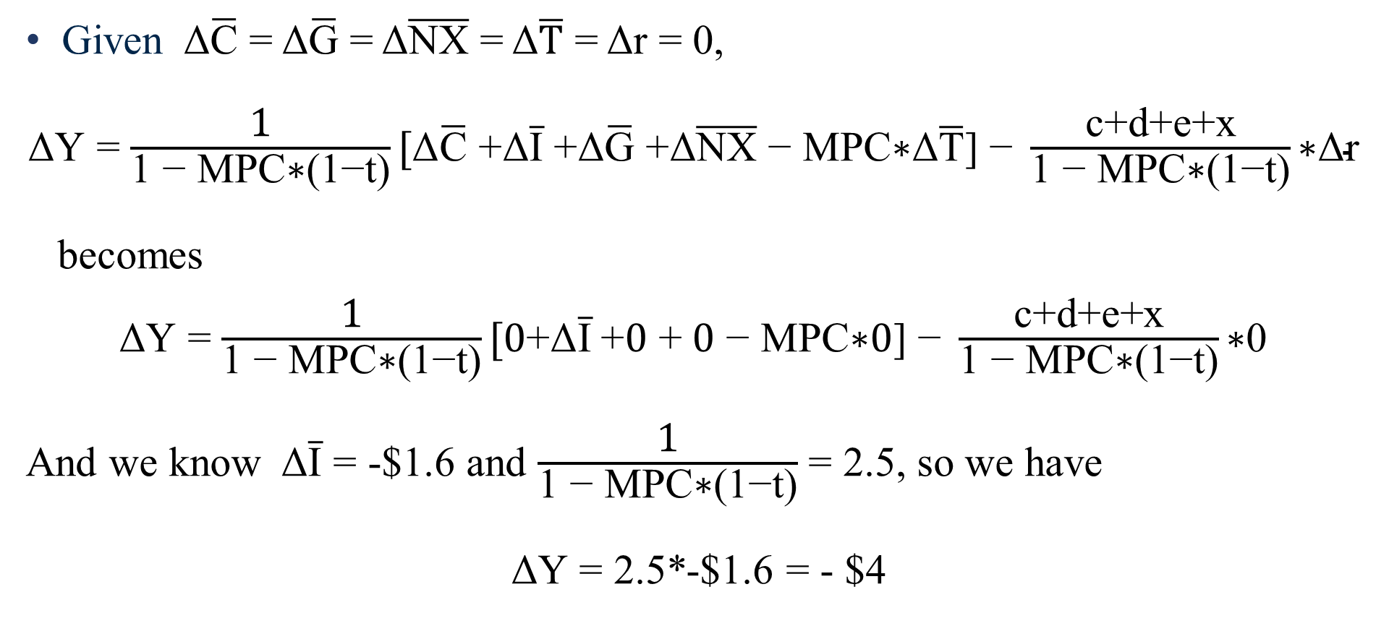

Closing the gap
Given Δ$\overline{\text{C}}$ = Δ$\overline{\text{G}}$ = Δ$\overline{\text{NX}}$ = Δ$\overline{\text{T}}$ = Δr = 0,
$\text{Δ}\text{Y}$ = $\frac{\text{1}}{\text{1 − }\text{MPC}\text{∗(1−}\text{t}\text{)}}[\text{Δ}\overline{\text{C}}\text{ +}\text{Δ}\overline{\text{I}}\text{ +}\text{Δ}\overline{\text{G}}\text{ +}\text{Δ}\overline{\text{NX}}\text{ − }\text{MPC}\text{∗}\text{Δ}\overline{\text{T}}\text{] − }\frac{\text{c}\text{+}\text{d}\text{+}\text{e}\text{+}\text{x}}{\text{1 − }\text{MPC}\text{∗(1−}\text{t}\text{)}}\text{∗}\text{Δ}\text{r}$
becomes
$\text{Δ}\text{Y}$ = $\frac{\text{1}}{\text{1 − }\text{MPC}\text{∗(1−}\text{t}\text{)}}[0\text{+}\text{Δ}\overline{\text{I}} \text{+}0\text{ +} 0\text{ − }\text{MPC}\text{∗}0\text{] − }\frac{\text{c}\text{+}\text{d}\text{+}\text{e}\text{+}\text{x}}{\text{1 − }\text{MPC}\text{∗(1−}\text{t}\text{)}}\text{∗}\text{0}$
And we know Δ$\overline{\text{I}}$ = -$1.6 and $\frac{\text{1}}{\text{1 − }\text{MPC}\text{∗(1−}\text{t}\text{)}}$ = 2.5, so we have
$\text{Δ}\text{Y}$ = 2.5*-$1.6 = - $4

Slide 16



Closing the gap
Real interest rate
r
All else equal, in this example, when autonomous investment falls $1.6, equilibrium output falls $4
Since MP is flat, when IS shifts left by $4, equilibrium Y falls by $4
Remember that this graph holds prices constant – sticky prices make this math easier
ΔY = Δ$\overline{\text{I}}$ * multiplier
-$4 = -$1.6 * 2.5
r = 6%
MP
IS₂(r)
IS₁(r)
$11.5
$$\overline{Y}=$$
$15.5
Y
Notes:
Sticky prices make this easier. Which is to say, if we were to add an upward-sloping (medium-run / sticky wage) SRAS curve, the math would get messier. Here, all we need is the IS curve to solve for the change in output. If prices were changing at the same time, we would need AD *and* SRAS to model the change in Y when there’s a shift in aggregate expenditure.

Slide 17
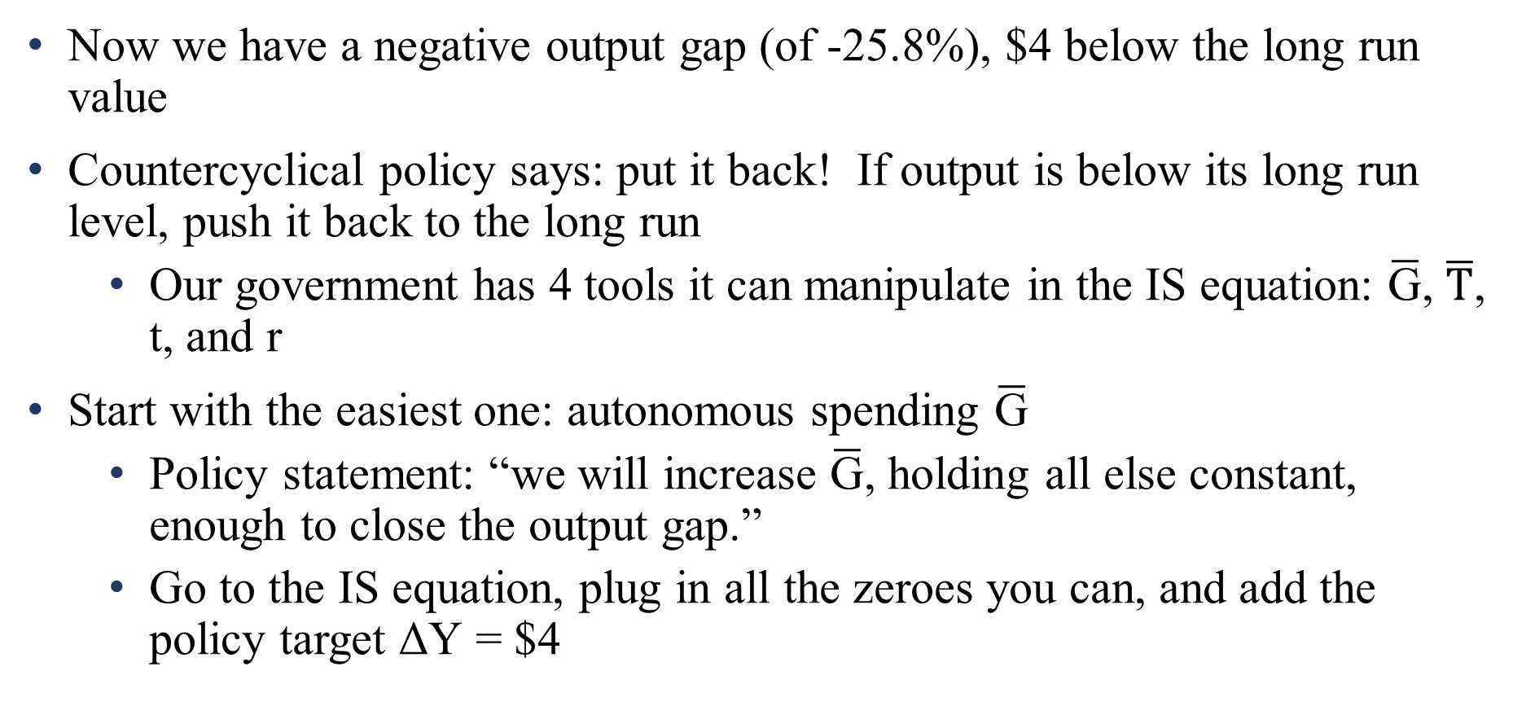
Closing the gap
Now we have a negative output gap (of -25.8%), $4 below the long run value
Countercyclical policy says: put it back! If output is below its long run level, push it back to the long run
Our government has 4 tools it can manipulate in the IS equation: $\overline{\text{G}}$, $\overline{\text{T}}$, t, and r
Start with the easiest one: autonomous spending $\overline{\text{G}}$
Policy statement: “we will increase $\overline{\text{G}}$, holding all else constant, enough to close the output gap.”
Go to the IS equation, plug in all the zeroes you can, and add the policy target $\text{Δ}\text{Y}$ = $4
Notes:
The output gap is (11.5-15-5)/15.5 = -4/15.5 = -0.258

Slide 18
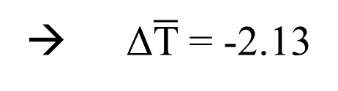
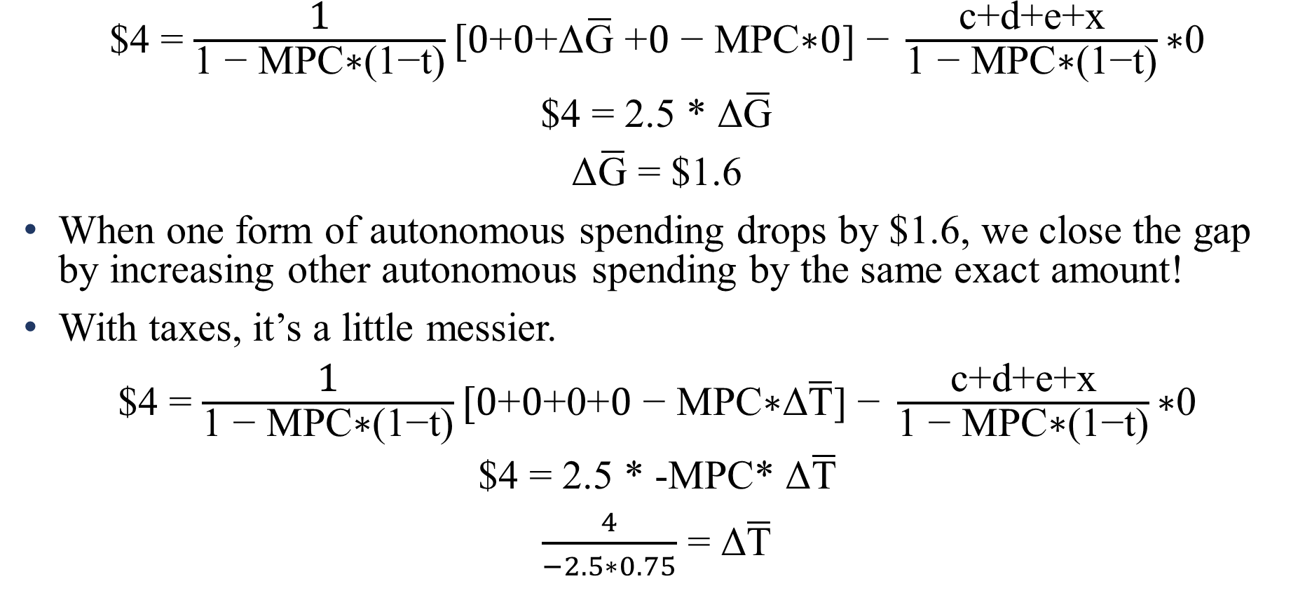
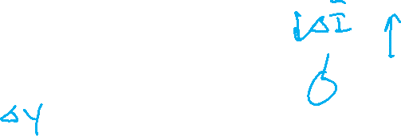
Closing the gap
$\text{\$4}$ = $\frac{\text{1}}{\text{1 − }\text{MPC}\text{∗(1−}\text{t}\text{)}}[0\text{+}0\text{+}\text{Δ}\overline{\text{G}}\text{ +}0\text{ − }\text{MPC}\text{∗}0\text{] − }\frac{\text{c}\text{+}\text{d}\text{+}\text{e}\text{+}\text{x}}{\text{1 − }\text{MPC}\text{∗(1−}\text{t}\text{)}}\text{∗}\text{0}$
$4 = 2.5 * $\text{Δ}\overline{\text{G}}$
$\text{Δ}\overline{\text{G}}$ = $1.6
When one form of autonomous spending drops by $1.6, we close the gap by increasing other autonomous spending by the same exact amount!
With taxes, it’s a little messier.
$\text{\$4}$ = $\frac{\text{1}}{\text{1 − }\text{MPC}\text{∗(1−}\text{t}\text{)}}[0\text{+}0\text{+}\text{0}\text{+}0\text{ − }\text{MPC}\text{∗}\text{Δ}\overline{\text{T}}\text{] − }\frac{\text{c}\text{+}\text{d}\text{+}\text{e}\text{+}\text{x}}{\text{1 − }\text{MPC}\text{∗(1−}\text{t}\text{)}}\text{∗}\text{0}$
$4 = 2.5 * -MPC* $\text{Δ}\overline{\text{T}}$
$\frac{4}{−2.5∗0.75}$ = $\text{Δ}\overline{\text{T}}$
→ $\text{Δ}\overline{\text{T}}$= -2.13

Slide 19
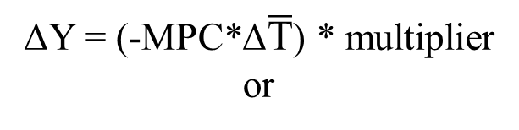

Closing the gap
$4 = (-0.75*-$2.13) * 2.5
ΔY = (-MPC*Δ$\overline{\text{T}}$) * multiplier
or
Real interest rate
r
G and T can both close the output gap. But they require different sized interventions
G is direct spending, and spending = income
A cut in T grants households more disposable income. But some income is spent while some is saved.
Only the spent portion, MPC, works as stimulus
ΔY = Δ$\overline{\text{G}}$ * multiplier
$4 = $1.6 * 2.5
r = 6%
MP
IS₃(r)
=
IS₂(r)
IS₁(r)
$11.5
$$\overline{Y}=$$
$15.5
Y

Slide 20
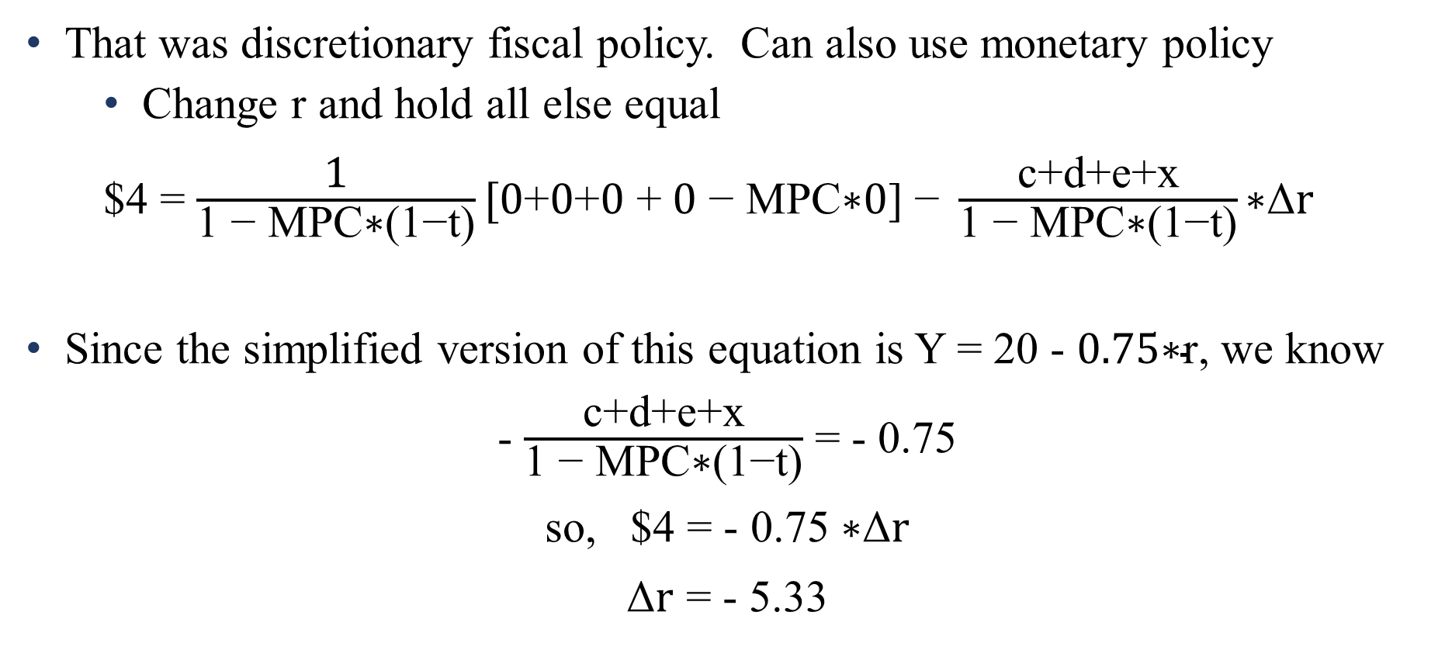
Closing the gap
That was discretionary fiscal policy. Can also use monetary policy
Change r and hold all else equal
$\text{\$4}$ = $\frac{\text{1}}{\text{1 − }\text{MPC}\text{∗(1−}\text{t}\text{)}}[0\text{+}0\text{+}0\text{ +} 0\text{ − }\text{MPC}\text{∗}0\text{] − }\frac{\text{c}\text{+}\text{d}\text{+}\text{e}\text{+}\text{x}}{\text{1 − }\text{MPC}\text{∗(1−}\text{t}\text{)}}\text{∗}\text{Δ}\text{r}$
Since the simplified version of this equation is Y = 20 - $0.75\text{∗}\text{r}$, we know
- $\frac{\text{c}\text{+}\text{d}\text{+}\text{e}\text{+}\text{x}}{\text{1 − }\text{MPC}\text{∗(1−}\text{t}\text{)}}$ = - 0.75
so, $4 = - 0.75 $\text{∗}\text{Δ}\text{r}$
$\text{Δ}\text{r}$ = - 5.33
Notes:
Watch the negative signs!!!!

Slide 21
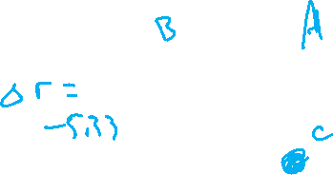

Closing the gap
Real interest rate
r
Given the new aggregate spending function IS₂(r), if we drop r by 5.33, the economy will be back in the long run
When r changes, the MP curve shifts
Notice that we’re using the interaction of the multiplier and the slopes of the four spending curves here.
$4 = 5.33 * -0.75
ΔY = Δ$\text{r}$*(c+d+e+x)*multiplier
r = 6%
MP₁
r = 0.66%
MP₂
IS₂(r)
IS₁(r)
$11.5
$$\overline{Y}=$$
$15.5
Y

Slide 22
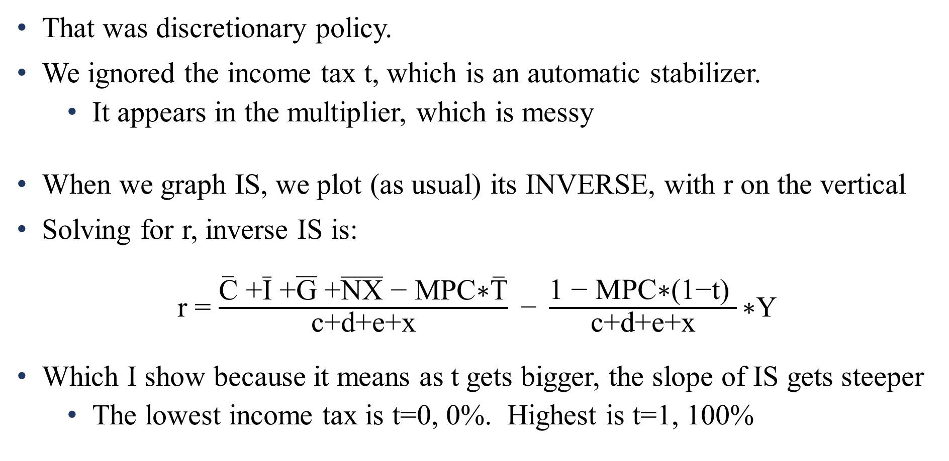
Fiscal policy
That was discretionary policy.
We ignored the income tax t, which is an automatic stabilizer.
It appears in the multiplier, which is messy
When we graph IS, we plot (as usual) its INVERSE, with r on the vertical
Solving for r, inverse IS is:
r = $\frac{\overline{\text{C}}\text{ +}\overline{\text{I}}\text{ +}\overline{\text{G}}\text{ +}\overline{\text{NX}}\text{ − }\text{MPC}\text{∗}\overline{\text{T}}}{\text{c}\text{+}\text{d}\text{+}\text{e}\text{+}\text{x}}\text{ − }\frac{\text{1 − }\text{MPC}\text{∗(1−}\text{t}\text{) }}{\text{c}\text{+}\text{d}\text{+}\text{e}\text{+}\text{x}}\text{∗}\text{Y}$
Which I show because it means as t gets bigger, the slope of IS gets steeper
The lowest income tax is t=0, 0%. Highest is t=1, 100%
Notes:
When t is zero, the slope has 1-MPC in its numerator. As t gets bigger, you’re multiplying by a number that is closer and closer to 0. You’re moving from 1 minus something to 1 minus nothing. 1 minus nothing is bigger!

Slide 23
Shocks and gaps
A higher t results in a lower level of output (taxes are contractionary!)
But a higher t protects us more from a given shock to autonomous spending
r
r
t=0.7, steep IS
r = 15%
t=0.1, flat IS
15%
-1
Flat
IS₁(r)
-1
r = 6%
MP
6%
MP
Steep
IS₁(r)
Flat
IS₂(r)
smaller
ΔY
Steep
IS₂(r)
big ΔY
$30
output (Y)
$15
output (Y)
Notes:
Notice that the intercept in the previous slide is NOT a function of t. So they will have the same y-intercept, but the higher t will decrease faster, and therefore equilibrium y will be lower.
Point 1: taxes are contractionary! Same with T and t.
Point 2: automatic stabilizers smooth out the business cycle.

Slide 24
Fiscal policy
Automatic stabilizers protect us from the slings and arrows of the business cycle.
For any given autonomous shock, our experience of it will be smaller, the more automatic stabilizers we have in place
When the economy takes a spending hit, the income tax automatically takes less from us that it would have otherwise.
It smooths out the business cycle, without any discretionary response required.
The unemployment insurance system did the same thing in the COVID crisis
Automatic stabilizers are fast and effective countercyclical tools!

Slide 25
Fiscal policy
Finally, we held inflation constant in all this. What if prices are not sticky
That is, what if, when we shift spending, we also change inflation?
Remember that when we shift either MP or IS, we shift AD.
If the shocks to the economy are on the demand side (shocks to aggregate expenditure), then all the previous advice remains
Expenditure shocks shift AD.
Fiscal and monetary policy shift AD.
So, when AD moves away from SRAS=LRAS, just put it back!

Slide 26




Fiscal policy
inflation (π)
inflation (π)
LRAS
LRAS
SRAS
SRAS
∆$\overline{\text{T}}$>0
∆ $\overline{\text{G}}$>0
AD₃
AD₁
AD₂
AD₂
AD₃
AD₁
$$\overline{Y}$$
output (Y)
$$\overline{Y}$$
output (Y)
negative AD shock
positive AD shock
Notes:
These are illustrations of the fundamental Keynesian theory, the one presented in earlier lectures, that the business cycle reflects DEMAND side fluctuations

Slide 27
Fiscal policy
If the shock is a supply-side shock, however, the choice is harder. There are trade-offs
When SRAS shifts, and then we move AD around, we will put the economy in a NEW long run
Same output as before, but a different rate of inflation
Suppose there’s a negative SRAS shock. Growth slows, inflation rises. How do you correct that?
“Correct” that by shifting AD out, causing even more inflation
It’s not clear that the economy is better off in this situation (see: the 1970s)

Slide 28
Fiscal policy
inflation (π)
inflation (π)
LRAS
LRAS
SRAS₂
SRAS₁
π_{LR}
if gap-
close
SRAS₁
π_{LR}
if self-
correct
SRAS₂
π_{LR}
if self-
correct
π_{LR}
if gap-
close
AD₁
AD₁
$$\overline{Y}$$
output (Y)
$$\overline{Y}$$
output (Y)
negative SRAS shock
positive SRAS shock
Notes:
The point: Non-intervensionism seems like a more appealing option given SRAS shocks than given AD shocks. There is always an output/inflation tradeoff when countering SRAS shocks, and it’s hard to say that the changes we cause in price level are “worth it” compared to the growth rate stabilization we generate.

Slide 29
Fiscal policy
Context will matter!
Negative SRAS shock
Raising inflation from 2% to 4% is no big deal, if it means keeping millions of people out of unemployment and promoting macro stability
Raising inflation from 8% to 13% is a much harder row to hoe…
Positive SRAS shock
If we can both smooth consumption and drop inflation from 6% to 3%, that’s excellent
Dropping inflation into negative values in the name of “gap closing” could be disastrous.

Slide 30
Next: The Philips Curve

